Slide 1
Design and Verification of 1×3 Router Using UVM
Presented By-
2310040114-Y.AshrithaVathsala
2310040115-Y.Amuktha Malyada
2310049152-k.Bhavya sree

Slide 2

Problem Statement and Objectives
Problem Statement
Modern communication systems require efficient and low-power routing mechanisms.
Conventional router designs consume higher power and lack systematic verification.
There is a need for a reliable 1×3 router with optimized power and robust verification.
Objectives
To design a 1×3 router using Verilog HDL.
To implement clock gating for power reduction.
To verify the design using Universal Verification Methodology (UVM).
To analyze performance in terms of functionality and power consumption.

Slide 3
Literature Survey / Background Study
Overview of Previous Works
Various researchers have designed and verified routers using RTL and UVM.
Earlier works focused on:
  Router architectures
  Buffer management
  Power optimization
  Verification environments
Key Observations
UVM improves verification efficiency.
Clock gating reduces dynamic power.
FIFO-based routers enhance data handling.
Related Studies
Design and verification of 1×5 and 1×3 routers.
FPGA-based low-power routers.
UVM-based verification architectures.

Slide 4
Knowledge Gap
Identified Gaps
Limited focus on power optimization in FSM modules.
Lack of integrated approach combining clock gating and UVM.
Few designs demonstrate measurable power savings.
Need for improved energy-efficient router architecture
Research Gap Addressed
Implementation of clock gating in FSM.
Comprehensive UVM-based verification.
Performance comparison with standard design

Slide 5
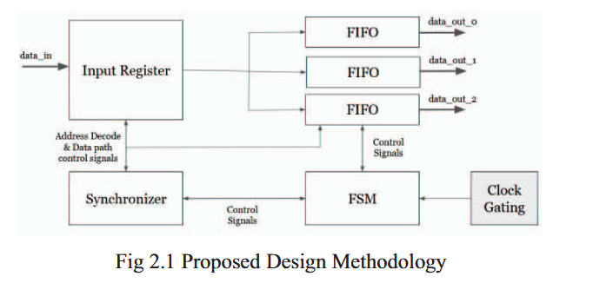
Methodology and Proposed Work Plan
System Architecture
The router consists of:
Input Register
Synchronizer
FSM (Finite State Machine)
Three FIFO Buffers
Design Methodology
RTL Design using Verilog
Module Integration
Clock Gating Implementation
UVM Testbench Development
Functional Verification
Power Analysis

Slide 6
Power Reduction Technique
Clock gating applied to FSM module.
Disables clock during idle states.
Reduces unnecessary switching.
UVM Verification Flow
Agent (Driver, Monitor, Sequencer)
Scoreboard
Environment
Test and Sequences

Slide 7
Work Plan
Phase | Activity
Phase 1 | Literature Review
Phase 2 | RTL Design
Phase 3 | Clock Gating
Phase 4 | UVM Testbench
Phase 5 | Simulation
Phase 6 | Analysis & Report

Slide 8
Expected Outcomes
Technical Outcomes
Functional 1×3 router design.
Verified using UVM methodology.
Reduced power consumption.
Error-free packet routing.
Performance Outcomes
Improved energy efficiency (~9.4% reduction).
Reliable data transmission.
Robust verification environment.
Learning Outcomes
Practical exposure to RTL and UVM.
Understanding of power optimization.
Experience in VLSI verification flow.

Slide 9
REFERENCES
[1] A. S. Tanenbaum and D. J. Wetherall, Computer Networks, 5th ed. Pearson, 2011.
[2] W. J. Dally and B. Towles, Principles and Practices of Interconnection Networks. Morgan Kaufmann, 2004.
[3] R. Buyya et al., “Internet of Things (IoT): A vision, architectural elements, and future directions,” Future Generation Computer Systems, vol. 29, no. 7, pp. 1645–1660, 2013.
[4] J. F. Kurose and K. W. Ross, Computer Networking: A Top-Down Approach, 7th ed. Pearson, 2017.
[5] C. E. Leiserson et al., “The network architecture of the Connection Machine CM-5,” J. Parallel Distrib. Comput., vol. 33, no. 2, pp. 145–158, 1996.
[6] L. Benini and G. De Micheli, “Networks on chips: A new SoC paradigm,” IEEE Computer, vol. 35, no. 1, pp. 70–78, Jan. 2002.

